Slide 1
Chapter 10
Body Structure and Function

Slide 2
A Steady State
Homeostasis
Various body functions and processes work to promote health and survival.
Homeostasis is affected by illness, disease, and injury.
Knowing the body’s normal structure (anatomy) and function (physiology) will help you understand signs, symptoms, and the reasons for care and procedures.
Notes:
You help residents meet their basic needs.
Your care promotes comfort, healing, and recovery.
You will give safe and more efficient care.
See Chapter 12 for changes in body structure and function that occur with aging.

Slide 3
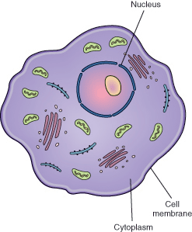
Cells, Tissues, and Organs
The basic unit of body structure is the cell.
Parts of a cell:
The cell membrane is the outer covering. It encloses the cell and helps it hold its shape.
The nucleus is the control center of the cell.
The cytoplasm surrounds the nucleus.
Notes:
Cells have the same basic structure.
Function, size, and shape may differ.
Protoplasm refers to all structures, substances, and water within the cell.
Each cell has 46 chromosomes.
Cells reproduce by dividing in half (mitosis).

Slide 4
Cells, Tissues, and Organs (Cont.)
Groups of cells with similar functions combine to form tissues.
Epithelial tissue covers internal and external body surfaces.
Connective tissue anchors, connects, and supports other tissues.
Muscle tissue stretches and contracts to let the body move.
Nerve tissue receives and carries impulses to the brain and back to body parts.
Groups of tissues with the same function form organs.
Systems are formed by organs that work together to perform special functions.
Notes:
Cells are the body’s building blocks.

Slide 5
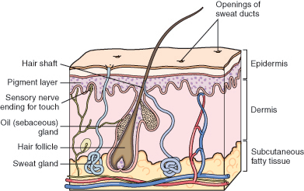
The Integumentary System
The integumentary system, or skin, is the largest system.
There are two skin layers.
The epidermis is the outer layer.
The dermis is the inner layer.
Notes:
The skin covers the body. It has epithelial, connective, and nerve tissue.
Oil glands and sweat glands, hair, and nails are skin appendages.
Hair covers the entire body, except the palms of the hands and the soles of the feet.
Nails protect the tips of the fingers and toes. They help fingers pick up and handle small objects.
Sweat glands help the body regulate temperature.
Oil glands (sebaceous glands) help keep the hair and skin soft and shiny.

Slide 6
The Integumentary System (Cont.)
The skin has many functions.
It is the body’s protective covering.
It prevents microorganisms and other substances from entering the body.
It prevents excess amounts of water from leaving the body.
It protects organs from injury.
Nerve endings in the skin sense both pleasant and unpleasant stimulation.
It helps regulate body temperature.
It stores fats and water.

Slide 7
The Musculoskeletal System
The musculoskeletal system provides the framework for the body.
It lets the body move.
It protects internal organs and gives the body shape.
Bones
There are four types of bones.
Long bones bear the body’s weight.
Short bones allow skill and ease in movement.
Flat bones protect the organs.
Irregular bones allow various degrees of movement and flexibility.
Bone marrow forms blood cells.
Notes:
The human body has 206 bones.
Bones are hard, rigid structures made up of living cells.
Bones are covered by a membrane called periosteum. Periosteum contains blood vessels that supply bone cells with oxygen and food.
Bone marrow is inside the hollow centers of the bones.

Slide 8
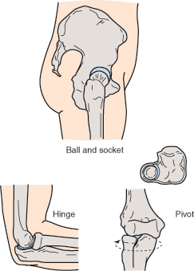
The Musculoskeletal System (Cont.)
A joint is the point at which two or more bones meet.
Joints allow movement.
There are three major types of joints.
Ball-and-socket joint allows movement in all directions.
Hinge joint allows movement in one direction.
Pivot joint allows turning from side to side.
Notes:
Cartilage is the connective tissue at the end of the long bones.
It cushions the joint so that the bone ends do not rub together.
The synovial membrane lines the joints. It secretes synovial fluid.
Synovial fluid acts as a lubricant.
Bones are held together at the joint by strong bands of connective tissue called ligaments.
Some joints are immovable. They connect the bones of the skull.

Slide 9
The Musculoskeletal System (Cont.)
Muscles
Voluntary muscles can be consciously controlled.
Involuntary muscles work automatically.
You cannot control them.
Cardiac muscle is in the heart.
It is an involuntary muscle.
Muscles have three functions.
Movement of body parts
Maintenance of posture or muscle tone
Production of body heat
Sphincters
Circular bands of muscle fibers
Constrict (narrow) a passage
Notes:
The human body has more than 500 muscles.
Muscles attached to bones (skeletal muscles) are voluntary. Skeletal muscles are striated. (They look striped or streaked.)
Involuntary muscles control the action of the stomach, intestines, blood vessels, and other body organs. Involuntary muscles also are called smooth muscles. They look smooth, not streaked or striped.
Strong, tough connective tissues called tendons connect muscles to bones.
Sphincters close a natural body opening.

Slide 10
The Nervous System
The nervous system controls, directs, and coordinates body functions.
It has two main divisions.
The central nervous system (CNS) consists of the brain and spinal cord.
The peripheral nervous system involves the nerves throughout the body.
Notes:
Nerves connect to the spinal cord. They carry messages or impulses to and from the brain.
Nerves are easily damaged and take a long time to heal.
Some nerve fibers have a protective covering called a myelin sheath.
Myelin sheath also insulates the nerve fiber. Nerves covered with it conduct impulses faster than those without.

Slide 11
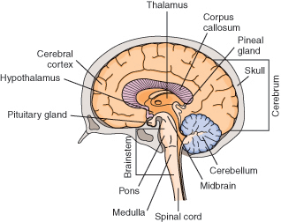
The Nervous System (Cont.)
Central nervous system
The brain is covered by the skull.
The three main parts of the brain
Cerebrum
Cerebellum
Brainstem
Notes:
The cerebrum is the largest part of the brain. It is the center of thought and intelligence.
The cerebellum regulates and coordinates body movements. It controls balance and the smooth movements of voluntary muscles.
The brainstem connects the cerebrum to the spinal cord. The brainstem contains the midbrain, pons, and medulla.
The midbrain and pons relay messages between the medulla and the cerebrum.
The medulla controls heart rate, breathing, blood vessel size, swallowing, coughing, and vomiting.

Slide 12
The Nervous System (Cont.)
The spinal cord lies within the spinal column.
The spinal cord contains pathways that conduct messages to and from the brain.
The brain and spinal cord are covered and protected by three layers of connective tissue called meninges.
The outer layer (dura mater) lies next to the skull.
The middle layer is the arachnoid.
The inner layer is the pia mater.
Notes:
The arachnoid space (between the middle layer and inner layer) is filled with cerebrospinal fluid.
Cerebrospinal fluid circulates around the brain and spinal cord.
Cerebrospinal fluid protects the central nervous system. It cushions shocks.

Slide 13
The Nervous System (Cont.)
Peripheral nervous system
It involves the nerves throughout the body.
The peripheral nervous system has 12 pairs of cranial nerves and 31 pairs of spinal nerves.
Cranial nerves conduct impulses between the brain and the head, neck, chest, and abdomen.
Spinal nerves carry impulses from the skin, extremities, and the internal structures not supplied by cranial nerves.
Notes:
Some peripheral nerves form the autonomic nervous system. This system controls involuntary muscles and certain body functions.
The autonomic nervous system is divided into the sympathetic nervous system and the parasympathetic nervous system. They balance each other.
The sympathetic nervous system speeds up functions.
The parasympathetic nervous system slows functions.

Slide 14
The Nervous System (Cont.)
The sense organs
The five senses are sight, hearing, taste, smell, and touch.
Receptors for taste are in the tongue (taste buds).
Receptors for smell are in the nose.
Touch receptors are in the dermis, especially in the toes and fingertips.

Slide 15
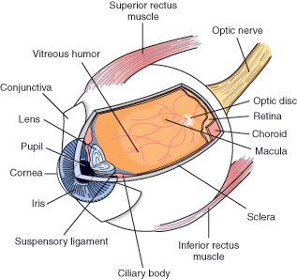
The Nervous System (Cont.)
The eye
Receptors for vision are in the eyes.
The eye has three layers.
The sclera is the outer layer.
The choroid is the second layer.
The retina is the inner layer.
Notes:
Bones of the skull, eyelids and eyelashes, and tears protect the eyes from injury.
The sclera is made of tough connective tissue.
Blood vessels, the ciliary muscle, and the iris make up the choroid. The iris gives the eye its color. The opening in the middle of the iris is the pupil.
The retina has receptors for vision and the nerve fibers of the optic nerve.

Slide 16
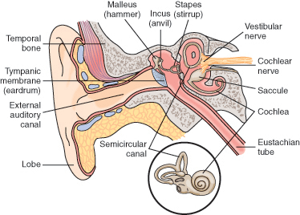
The Nervous System (Cont.)
The ear
The ear functions in hearing and balance.
It has three parts: the external ear, the middle ear, and the inner ear.

Slide 17
The Nervous System (Cont.)
The external ear is called the pinna or auricle.
The eardrum (tympanic membrane) separates the external and middle ear.
The middle ear contains the eustachian tube and three small bones called ossicles.
The ossicles are the malleus, the incus, and the stapes.
The inner ear consists of the semicircular canals and the cochlea.
The cochlea contains fluid that carries sound waves to the acoustic nerve.
The three semicircular canals are involved with balance.
Notes:
Glands in the auditory canal secrete a waxy substance called cerumen.
The eustachian tube connects the middle ear and the throat. Air enters the eustachian tube so that there is equal pressure on both sides of the eardrum.
The ossicles amplify sound received from the eardrum and transmit the sound to the inner ear.

Slide 18
The Circulatory System
The circulatory system is made up of the blood, heart, and blood vessels.
The circulatory system has many functions.
Blood carries food, hormones, and other substances to the cells.
Blood transports the gases of respiration.
Blood removes waste products from cells.
Blood plays a role in maintaining the body’s fluid balance.
Blood and blood vessels help regulate body temperature.
The system produces and carries cells that defend the body from microbes that cause disease.
Notes:
The heart pumps blood through the blood vessels.
Blood brings oxygen to the cells and removes carbon dioxide from the cells.

Slide 19
The Circulatory System (Cont.)
The blood
The blood consists of blood cells and plasma.
Plasma is mostly water.
Red blood cells (RBCs) are called erythrocytes.
They give blood its red color because of a substance in the RBC called hemoglobin.
White blood cells (WBCs) are called leukocytes.
They protect the body against infection.
Platelets (thrombocytes) are needed for blood clotting.
Notes:
Plasma carries blood cells to other body cells. It also carries substances that cells need to function.
Hemoglobin carries oxygen to the cells. Cells release carbon dioxide (a waste product). It is picked up by the hemoglobin.
At the first sign of infection, WBCs rush to the infection site.

Slide 20
The Circulatory System (Cont.)
The heart is a muscle.
It pumps blood through the blood vessels to the tissues and cells.
It lies in the middle to lower part of the chest cavity toward the left side.
The heart is hollow and has three layers.
The pericardium is the outer layer.
The myocardium is the thick, muscular part of the heart.
The endocardium lines the inner surface of the heart.

Slide 21
The Circulatory System (Cont.)
The heart has four chambers.
Upper chambers receive blood and are called atria.
The right atrium receives blood from body tissues.
The left atrium receives blood from the lungs.
Lower chambers pump blood and are called ventricles.
The right ventricle pumps blood to the lungs for oxygen.
The left ventricle pumps blood to all parts of the body.
Valves are between the atria and ventricles.
Heart action has two phases.
Diastole is the resting phase.
Systole is the working phase.
Notes:
The valves allow blood flow in one direction.
The tricuspid valve is between the right atrium and the right ventricle.
The mitral valve (bicuspid valve) is between the left atrium and the left ventricle.
Heart chambers fill with blood during diastole.
Blood is pumped through the blood vessels during systole.

Slide 22
The Circulatory System (Cont.)
The blood vessels
Arteries carry blood away from the heart.
The aorta is the largest artery.
The smallest branch of an artery is an arteriole.
Capillaries are very tiny blood vessels.
The capillaries pick up waste products from the cells.
Veins return blood to the heart.
The two main veins are the inferior vena cava and the superior vena cava.
Notes:
Arterial blood is rich in oxygen.
The aorta receives blood directly from the left ventricle.
The aorta branches into other arteries that carry blood to all parts of the body.
Food, oxygen, and other substances pass from capillaries into the cells.
Veins carry waste products back to the heart.
Veins connect to the capillaries by small veins called venules.
The inferior vena cava and the superior vena cava empty into the right atrium.
Venous blood has little oxygen and a lot of carbon dioxide.

Slide 23
The Lymphatic System
The lymphatic system is a complex network that transports lymph throughout the body.
The lymphatic system
Collects extra lymph from the tissues and returns it to the blood; this helps maintain fluid balance
Defends the body against infection by producing lymphocytes
Absorbs fats from the intestines and transports them to the blood
Notes:
Lymph is a clear, thin, watery fluid that contains proteins and fats from the intestines. It also contains white blood cells.
Water, proteins, and other substances normally leak out of the capillaries into surrounding tissues. The lymphatic system drains the extra fluid from the tissues to prevent swelling.
Lymphocytes are a type of white blood cell that defends the body against microorganisms that cause infection.

Slide 24
The Lymphatic System (Cont.)
Right lymphatic duct
Collects lymph from the right arm and from the right side of the head, neck, and chest
Empties into a vein on the right side of the neck
Thoracic duct
Collects lymph from the pelvis, abdomen, lower chest, and rest of the body
Empties into a vein on the left side of the neck
Notes:
Lymph is formed in the tissues and is transported by lymphatic vessels to the right lymphatic duct and the thoracic duct. It then enters the blood in veins near the neck.
Lymph nodes found in the neck, underarm, groin area, chest, abdomen, and pelvis filter bacteria, cancer cells, and damaged cells from the lymph. This prevents such substances from entering the blood and circulating throughout the body.

Slide 25
The Lymphatic System (Cont.)
Tonsils and adenoids
Trap microorganisms in the mouth and nose to help prevent infection
Spleen
Is the largest structure in the lymphatic system
Has a rich blood supply
Filters and removes bacteria and other substances
Destroys old RBCs
Saves the iron found in hemoglobin when RBCs are destroyed
Stores blood
Notes:
Tonsils are in the back of the throat. Adenoids are behind the nose.
The spleen is about the size of a fist.
When needed, blood stored in the spleen is returned to the circulatory system.

Slide 26
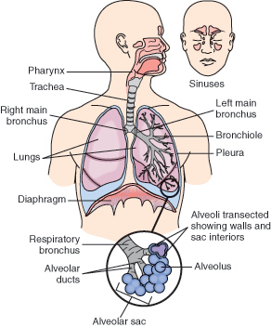
The Respiratory System
The respiratory system brings oxygen into the lungs and removes carbon dioxide.
Notes:
Oxygen is needed to live.
Every cell needs oxygen.
Respiration is the process of supplying the cells with oxygen and removing carbon dioxide from them.

Slide 27
The Respiratory System (Cont.)
Respiration involves inhalation (inspiration) and exhalation (expiration).
The lungs are spongy tissues filled with alveoli, blood vessels, and nerves.
Each lung is divided into lobes.
The right lung has three lobes; the left lung has two.
The lungs are separated from the abdominal cavity by a muscle called the diaphragm.
Each lung is covered by a two-layered sac called the pleura.
A bony framework made up of the ribs, sternum, and vertebrae protects the lungs.
Notes:
Air enters the body through the nose and then passes into the pharynx (throat).
Air passes from the pharynx into the larynx (voice box). During inhalation, the epiglottis lifts up to let air pass over the larynx.
Air passes from the larynx into the trachea (windpipe). The trachea divides into the right bronchus and the left bronchus. Each bronchus enters a lung. The bronchi divide many times into smaller branches called bronchioles. The bronchioles end up in tiny, one-celled air sacs called alveoli. Alveoli are supplied by capillaries.
Oxygen and carbon dioxide are exchanged between the alveoli and the capillaries.
Blood in the capillaries picks up oxygen from the alveoli.
Then the blood is returned to the left side of the heart and is pumped to the rest of the body.
Alveoli pick up carbon dioxide from the capillaries for exhalation.

Slide 28
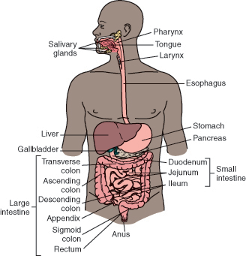
The Digestive System
The digestive system (gastrointestinal [GI] system)

Slide 29
The Digestive System (Cont.)
Digestion
Breaks down food physically and chemically so it can be absorbed for use by the cells
Removes solid wastes from the body
The digestive system involves the alimentary canal (GI tract) and the accessory organs of digestion.
Its major parts are the mouth, pharynx, esophagus, stomach, small intestine, and large intestine.
Accessory organs are the teeth, tongue, salivary glands, liver, gallbladder, and pancreas.
Notes:
The process of digestion begins in the mouth.
During swallowing, the tongue pushes food into the pharynx. Contraction of the pharynx pushes food into the esophagus.
Involuntary muscle contractions called peristalsis move food down the esophagus through the alimentary canal.
In the stomach, food is mixed and churned with the gastric juices to form a semi-liquid substance called chyme.
Through peristalsis, the chyme is pushed from the stomach into the small intestine.
Undigested chyme passes from the small intestine into the large intestine.
The colon absorbs most of the water from the chyme. The remaining semi-solid material is called feces. Feces pass through the colon into the rectum by peristalsis.
Feces pass out of the body through the anus.

Slide 30
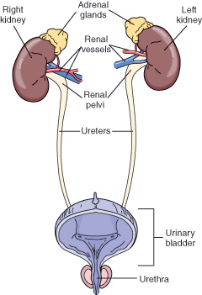
The Urinary System
The urinary system
Removes waste from the blood
Maintains water balance within the body
Maintains electrolyte balance
Maintains acid-base balance
Notes:
Electrolytes are substances that dissolve in water: sodium, potassium, and calcium. Sodium is needed for fluid balance. Potassium and calcium are needed for the proper functioning of skeletal and cardiac muscles.
A pH scale measures if a substance is acidic, neutral, or basic. Blood must remain within a certain pH range (7.35 to 7.45) for the body to function normally.

Slide 31
The Urinary System (Cont.)
The kidneys are two bean-shaped organs in the upper abdomen.
The kidneys remove waste products from the blood.
Each kidney has a million tiny nephrons.
Each nephron is the basic working unit of the kidney.
The ureters carry urine from the kidneys to the bladder.
Urine is stored in the bladder until the need to urinate is felt.
Urine passes from the bladder through the urethra.
Urine passes from the body through the meatus.
Notes:
The kidneys lie against the back muscles on each side of the spine.
The bladder is a hollow, muscular sac. It lies toward the front in the lower part of the abdominal cavity.
Urine is a clear, yellowish fluid.

Slide 32
The Reproductive System
Human reproduction results from the union of a male sex cell and a female sex cell.
Differences in the male and female reproductive systems allow for the process of reproduction.

Slide 33
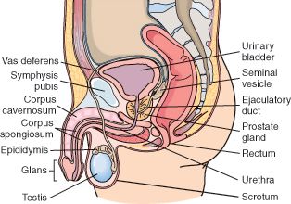
The Reproductive System (Cont.)
The male reproductive system
Notes:
The testes (testicles) are the male sex glands (gonads).
Male sex cells (sperm) are produced in the testes.
Testosterone, the male hormone, is produced in the testes.
The testes are suspended between the thighs in a sac called the scrotum.
Semen is a fluid that carries sperm from the male reproductive tract.
The penis is outside of the body and has erectile tissue. The erect penis can enter a female’s vagina. The semen, which contains sperm, is released into the vagina.

Slide 34
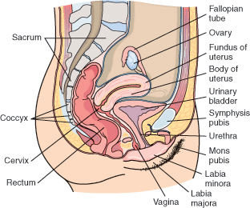
The Reproductive System (Cont.)
The female reproductive system
Notes:
The female gonads are two almond-shaped glands called ovaries.
An ovary is on each side of the uterus in the abdominal cavity. The ovaries contain ova (eggs). Ova are the female sex cells.
The ovaries secrete the female hormones estrogen and progesterone.
The uterus is a hollow, muscular organ shaped like a pear. If sex cells from the male and the female unite into one cell, that cell implants into the endometrium (the lining of the uterus).
The vagina opens to the outside of the body just behind the urethra. It receives the penis during intercourse. It is part of the birth canal.

Slide 35
The Reproductive System (Cont.)
The external female genitalia is called the vulva.
The mons pubis is a rounded, fatty pad over a bone called the symphysis pubis.
The labia majora and labia minora are two folds of tissue on each side of the vaginal opening.
The clitoris is a small organ composed of erectile tissue.
It becomes hard when sexually stimulated.
The mammary glands (breasts) secrete milk after childbirth.
Notes:
The mons pubis is covered with hair in the adult female.
The mammary glands are made up of glandular tissue and fat.

Slide 36
The Reproductive System (Cont.)
Menstruation
If pregnancy does not occur, the endometrium breaks up and is discharged from the body through the vagina.
The uniting of the sperm and ovum into one cell is called fertilization.
During intercourse, millions of sperm are deposited into the vagina.
If a sperm and an ovum unite in a fallopian tube, fertilization results.
The fertilized cell travels down the fallopian tube to the uterus.
The fertilized cell implants in the thick endometrium and grows during pregnancy.
Notes:
The endometrium is rich in blood to nourish the cell that grows into a fetus.
Menstruation is the process in which the lining of the uterus (endometrium) breaks up and is discharged from the body through the vagina. It occurs about every 28 days. This is called the menstrual cycle.
To reproduce, a male sex cell (sperm) must unite with a female sex cell (ovum).

Slide 37
The Endocrine System
The endocrine system is made up of glands called the endocrine glands.
The endocrine glands secrete chemical substances called hormones into the bloodstream.
Hormones regulate the activities of other organs and glands in the body.

Slide 38
The Endocrine System (Cont.)
The pituitary gland is called the master gland.
It is at the base of the brain behind the eyes.
The anterior pituitary lobe secretes:
Growth hormone (GH)
Thyroid-stimulating hormone (TSH)
Adrenocorticotropic hormone (ACTH)
Hormones that regulate growth, development, and function of the male and female reproductive systems
The posterior pituitary lobe secretes:
Antidiuretic hormone (ADH)
Oxytocin
Notes:
Growth hormone (GH) is needed for growth of muscles, bones, and other organs.
Thyroid-stimulating hormone (TSH) is needed for thyroid gland function.
Adrenocorticotropic hormone (ACTH) stimulates the adrenal gland.
Antidiuretic hormone (ADH) prevents the kidneys from excreting excessive amounts of water.
Oxytocin causes uterine muscles to contract during childbirth.

Slide 39
The Endocrine System (Cont.)
The thyroid gland is in the neck in front of the larynx.
The thyroid gland secretes thyroid hormone (TH, thyroxine).
There are four parathyroid glands.
Two lie on each side of the thyroid gland.
The parathyroid glands secrete parathormone.
Notes:
Thyroid hormone (TH, thyroxine) regulates metabolism (the burning of food for heat and energy by the cells).
Too little TH results in slowed body processes, slowed movements, and weight gain.
Too much TH causes increased metabolism, excess energy, and weight loss.
Parathormone regulates calcium use. Calcium is needed for nerve and muscle function.
Insufficient amounts of calcium cause tetany (a state of severe muscle contraction and spasm).

Slide 40
The Endocrine System (Cont.)
There are two adrenal glands.
The adrenal medulla secretes epinephrine and norepinephrine.
The adrenal cortex secretes three groups of hormones needed for life.
Glucocorticoids
Mineralocorticoids
Small amounts of male and female sex hormones
Notes:
An adrenal gland is on the top of each kidney.
Epinephrine and norepinephrine stimulate the body to quickly produce energy during emergencies.
Glucocorticoids regulate the metabolism of carbohydrates and control the body’s response to stress and inflammation.
Mineralocorticoids regulate the amount of salt and water that is absorbed and lost by the kidneys.

Slide 41
The Endocrine System (Cont.)
The thymus secretes the hormone thymosin.
The pancreas secretes insulin.
The gonads are the glands of human reproduction.
Male sex glands (testes) secrete testosterone.
Female sex glands (ovaries) secrete estrogen and progesterone.
Notes:
Thymosin is important for the development and function of the immune system.
Insulin regulates the amount of sugar in the blood available for use by the cells.
If there is too little insulin, sugar cannot enter the cells. If sugar cannot enter the cells, excess amounts of sugar build up in the blood. This condition is called diabetes.

Slide 42
The Immune System
Protects the body from disease and infection
Defends against threats inside and outside the body
Special cells and substances function to produce immunity.
Antibodies
Antigens
Phagocytes
Lymphocytes
B lymphocytes (B cells)
T lymphocytes (T cells)
When the body senses an antigen (an unwanted substance), the immune system reacts.
Notes:
“Immunity” means that a person has protection against a disease or condition.
Specific immunity is the body’s reaction to a certain threat.
Nonspecific immunity is the body’s reaction to anything it does not recognize as a normal body substance.
Antibodies destroy abnormal or unwanted substances.
Antigens cause an immune response.
Phagocyte and lymphocyte production increases.
Phagocytes destroy the invaders through digestion.
Lymphocytes produce antibodies.

